Slide 1
Simple GUI Calculator
Using tkinter in python

Slide 2
Introduction
Pyhton offers multiple options to develop GUI(Graphic User Interface) applications and Tkinter is the most commonly used method for this purpose.Python with Tkinter is the easiest and fastest way to create GUI.
In this project using above method a simple calculator is created which perform basic arithmetic functions.

Slide 3
Importing Tkinter
Once Pyhton is installed Tkinter is easily imported by following command.
from tkinter import *

Slide 4
Creating a Tkinter container
UI app requires a container or window to place various elements in it. To create a window following code is used.
root=Tk() #To create a root window
root.geometry("312x324")#Geometry method defines size of window
root.resizable(0,0)#Prevent resizing window
root.title("CALCULATOR")#To give title to window

Slide 5
User Click Functions
Btn_click(): Input a number or operation.
Btn_Clear(): Clear the input when required.
Btn_equal(): Calculate the expression on pressing equal sign.

Slide 6
Design the Application
Requirement | Functions Used
Create a frame for input field. | Frame(),Pack()
Create the input field which will display the input. | Entry(),grid(),pack(),ipady
Create a frame to display buttons on calculator. | Frame(),Pack()
Place the buttons in grid and configure them to trigger. | Button(),Lambda(),grid()

Slide 7
Lambda():Python Lambda Functions are anonymous functions means that the function is without a name.
Grid():The Grid geometry manager puts the widgets in a 2-dimensional table.
Frame():It is used to organize a group of widgets.
Pack():organizes buttons in horizontal and vertical boxes placed to left, right, top, bottom positions.
Entry:used to Enter or display a single line of text.

Slide 8
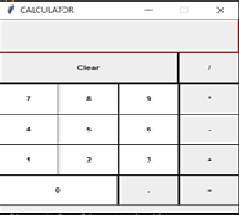
Interface

Slide 9
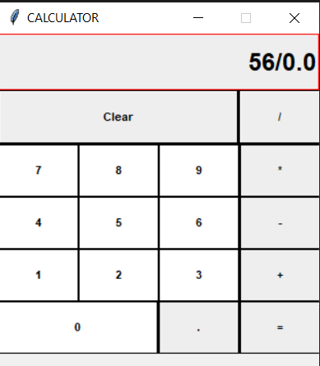
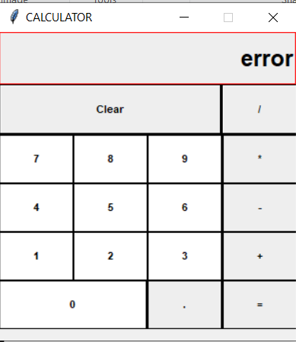
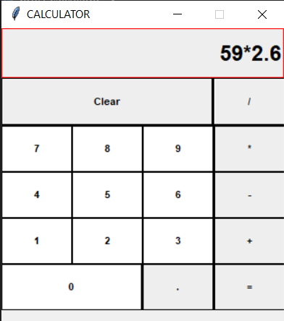
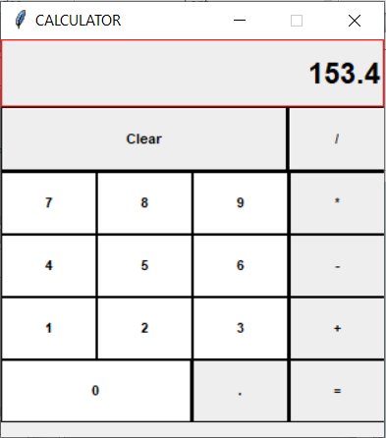
Inputs and Outputs

Slide 10
Summary
This project helped to understand the Tkinter library to create User Interface.
Using various techniques of Tkinter widget familarize us with creation frames and arranging widgets into that frame and how to trigger those events when interface used.

